Slide 1
Project Report on
Mobile Price Classification Using Machine Learning
by
Shibasis Karmakar
Internship Program
Under the Guidance of:
Mentorness

Slide 2
DECLARATION
I, Shibasis Karmakar, a working professional , have completed my Graduation from Calcutta University in 2010 on B.com(h). The Project Report on A Study on Mobile Price Classification Using Machine Learning in fulfilment of Internship program from Mentorness is the original work conducted by me.
The information and data given in the report is authentic to the best of my knowledge. This report has not been submitted to any other university for the award of any other degree, diploma and fellowship.
Shibasis Karmakar
Place: West Bengal(Kolkata)
Date of submission: 23/04/2024

Slide 3
Project Title
Data Sources
Data Sets
Tools used
Provided by Mentorness
Internship Project
Via Email.
Mobile Price
Test.xls & Train.xls
Total Row Total columns
2000 21
Software: Excel, Python, Jupyter Note book
Hardware: AMD Ryzen 3 2200G with Radeon Vega Graphics 3.50 GHz
Ram:8.00 GB.
Edition: Windows 10 pro

Slide 4
Introduction/Brief Description on Dataset
The task is to build a predictive model that can accurately classify mobile phones into predefined price
ranges based on various attributes such as battery power, camera features, memory, connectivity options,
and more. The dataset provided contains information about several mobile phones, including their
specifications and corresponding price ranges.
Dataset Description:
battery_power: Total energy a battery can store in mAh.
blue: Bluetooth enabled (1 if yes, 0 if no).
clock_speed: Speed at which microprocessor executes instructions.
dual_sim: Dual SIM support (1 if yes, 0 if no).
fc: Front Camera mega pixels.
four_g: 4G network support (1 if yes, 0 if no).
int_memory: Internal Memory (in gigabytes).
m_dep: Mobile Depth in cm.
mobile_wt: Weight of mobile phone.
n_cores: Number of cores of the processor.
pc: Primary Camera mega pixels.
px_height: Pixel Resolution Height.
px_width: Pixel Resolution Width.
ram: Random Access Memory in megabytes.
sc_h: Screen Height of mobile in cm.
sc_w: Screen Width of mobile in cm.
talk_time: Longest time that a single battery charge will last when you are talking.
three_g: 3G network support (1 if yes, 0 if no).
touch_screen: Touch screen support (1 if yes, 0 if no).
wifi: Wifi connectivity (1 if yes, 0 if no).
price_range: Price range of the mobile phone (0 - low cost, 1 - medium cost, 2 - high cost, 3 -very high cost).

Slide 5
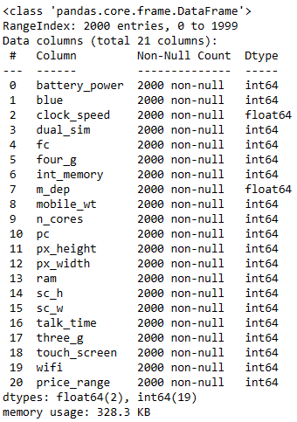
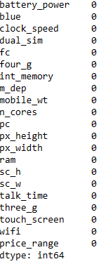

Basic info about the Data set
As per the Data Set we can see the numbers of columns & Rows, which is 2000 rows & 21 columns.
After the sanitary check we found Zero null values & there was no duplicate data found in the given data set.

Slide 6

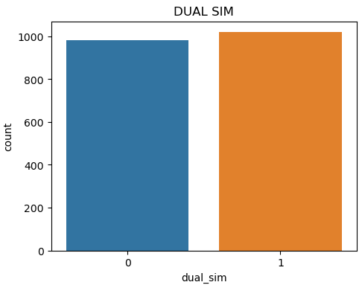
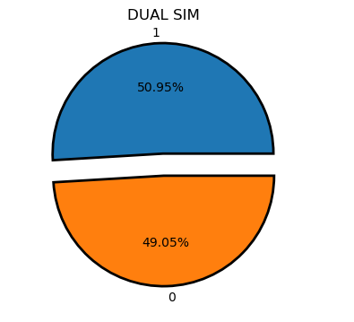
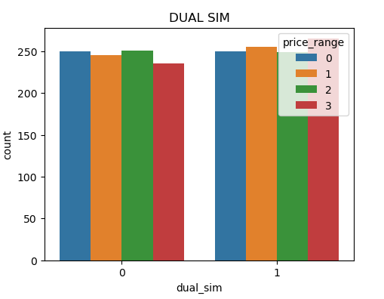
Mobile Sim slots
Her we can see there are two type of Slots available for Mobile.
Dual Sim slot which denotes as 1.
Single Sim Slot which denotes as 0.
In context of price people wants both type of mobile phone.
SIM slots Visualization wise in context of Price

Slide 7

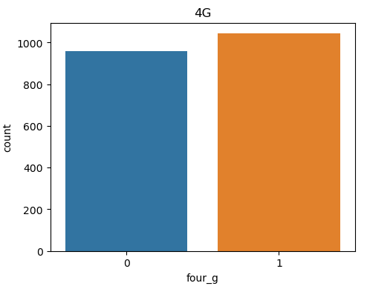
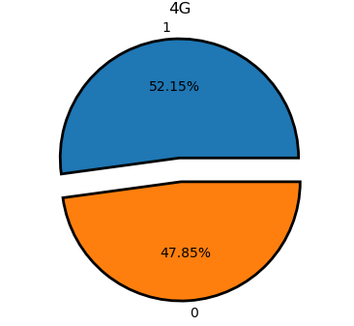
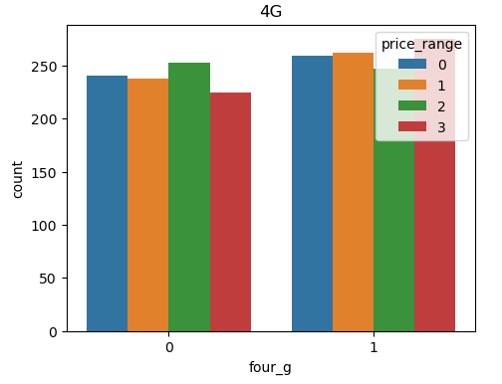
4g Enable on Mobile
As per the mobile Phone in the market, 4g is enable or not on the mobile phone
4g enable which denotes as 1.
4g not enable which denotes as 0.
As per below data in context of price both the status are more or less equally distributed
But with very high cost mobile phone with 4g enable has little overhand than others.
SIM slots Visualization wise in context of Price

Slide 8
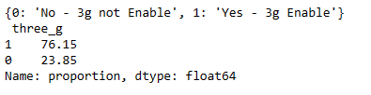
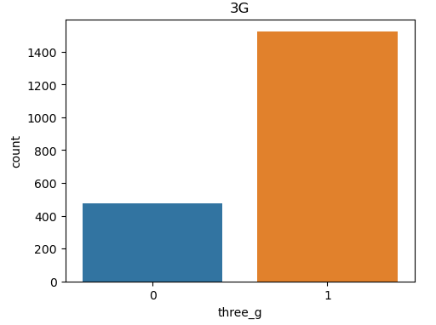
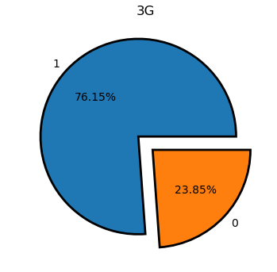
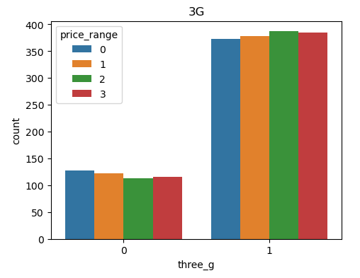
3g Enable on Mobile
As per the mobile Phone in the market, 3g is enable or not on the mobile phone
3g enable which denotes as 1.
3g not enable which denotes as 0.
As per below data 3g is enable in most of the mobile phone available in the market.
Even in context of price 3g enable status are more or less equal.
SIM slots Visualization wise in context of Price

Slide 9
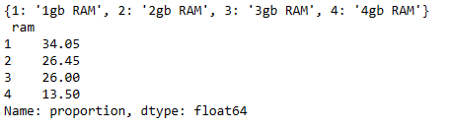
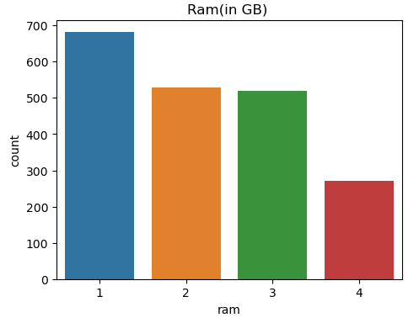
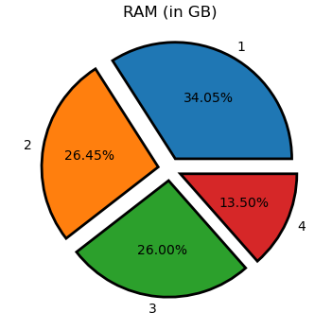
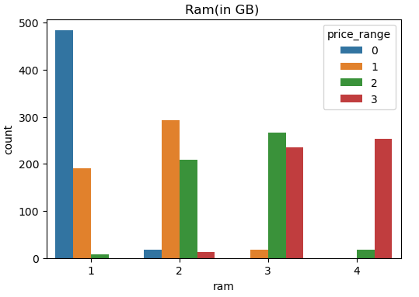
Ram Availability on Mobile
There are Four type of ram available in the current market on Mobile.
1gb, 2gb, 3gb, 4gb.
So as per the availability of ram in correspondence of price we can determine the percentage of consumption.
Ram availability Visualization wise in context of Price

Slide 10
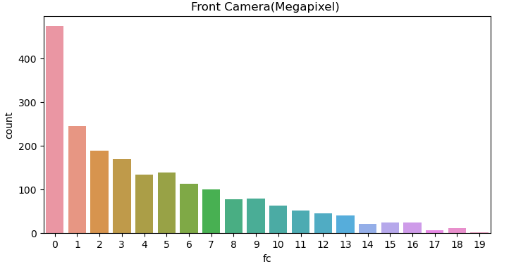
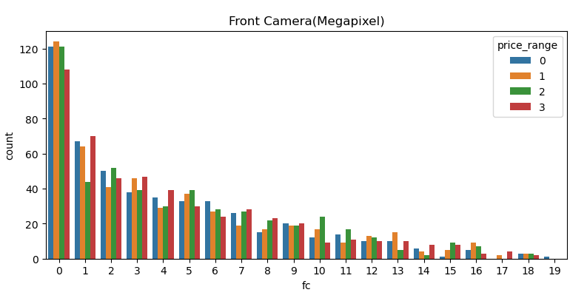
Front Camera Megapixel on Mobile
Front camera megapixel has significant role in a Mobile .
As per the below data suggest that maximum mobile has zero megapixel it means that mobile phone has no front camera.
Where as the highest Megapixel front camera which is 19 megapixel has least number
In Context of price we can also see that low cost price mobile with no front camera has high impact rather than high cost with 19 megapixel Camera.
Front camera Megapixel Visualization wise in context of Price

Slide 11
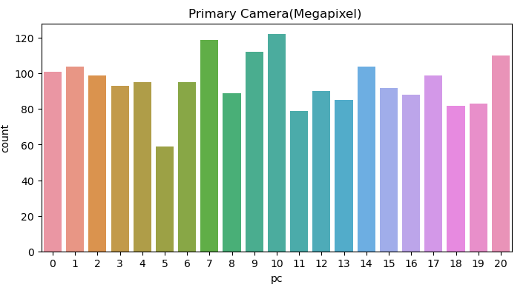
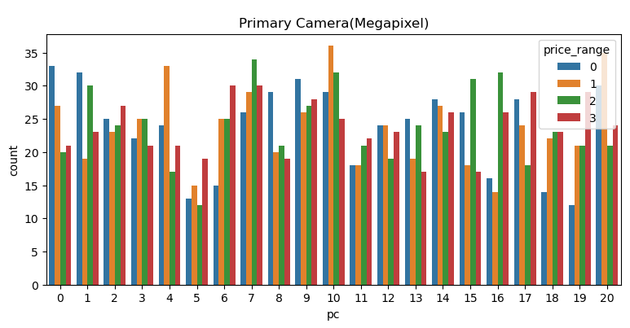
Primary Camera Megapixel on Mobile
Primary camera megapixel has an important role in a Mobile phone.
As per the below data suggest that maximum mobile has 7 to 10 megapixel and also the highest megapixel which is 20 has also good demand in the market.
Now in Context of price we can determine that the medium cost mobile phone with highest number of megapixel has greater impact on the market.
Primary camera Megapixel Visualization wise in context of Price

Slide 12

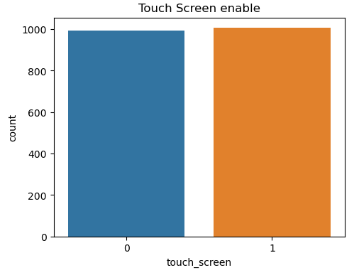
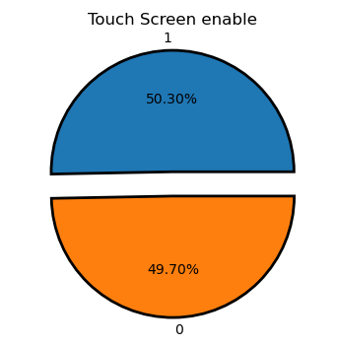
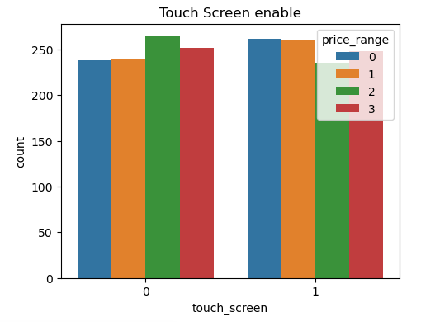
TOUCH Screen Availability on Mobile
Now a days maximum mobile phone in the market are touch screen but as per the data speaks something else.
Keypad mobile phone & Touch screen mobile are very much similar in availability .
People wants both type of phone.
Here Touch screen mobile denotes as 1
Non Touch screen mobile denotes as 0
Touch screen availability Visualization wise in context of Price

Slide 13
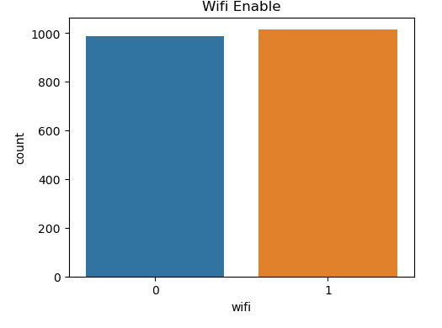
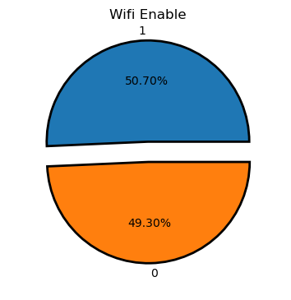
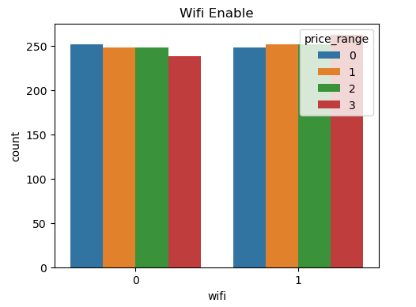
Wifi Availability on Mobile
WIFI Availability on Mobile
WIFI availability plays vital role now a days in every Mobile phone.
But according to the data we can see that there was quite equal distribution.
Significantly if we see in context of price there was little spike on very high cost mobile phone
WIFI availability Visualization wise in context of Price

Slide 14
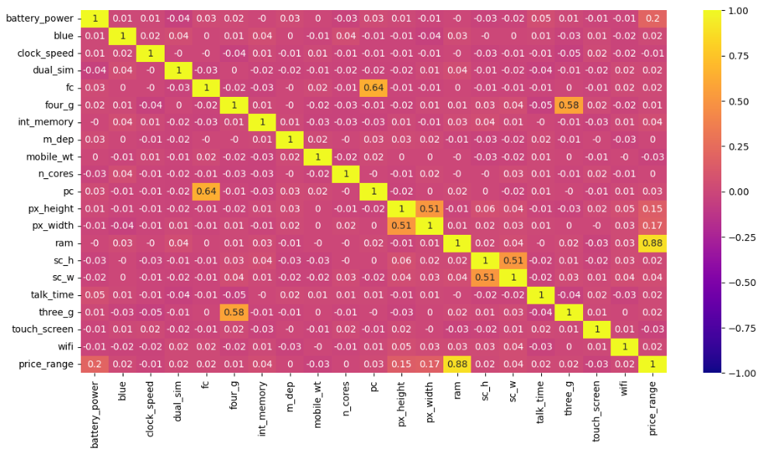
Correlation between the features on mobile
As per the below picture says that there was few positive correlation between
RAM & PRICE – which is significantly high i.e. 0.88
Front Camera & Primary Camera – which is 0.64
4g & 3g – which is 0.58 respectively.
But there was also some negative correlation exists like between
Talk time & WIFI – which is -0.03 respectivelty.

Slide 15
Machine Learning ALOGORITHMS
Decision
Tree
Classifier
Random
Forest
Classifier
Ada-boost
Classifier
Gradient
Boosting
classifier
Logistic
Regression

Slide 16

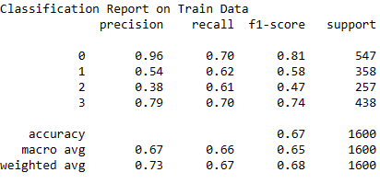
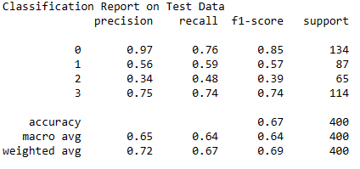
Decision Tree Classifier

Slide 17

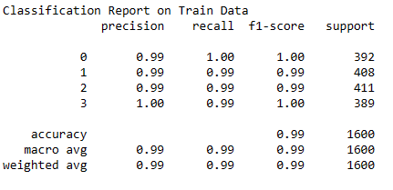
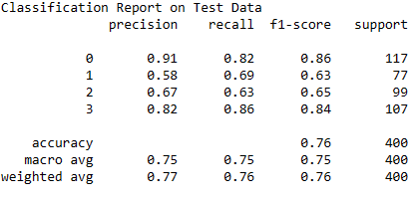
Random Forest Classifier

Slide 18

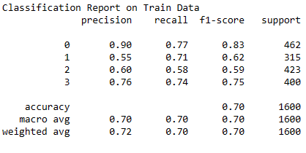
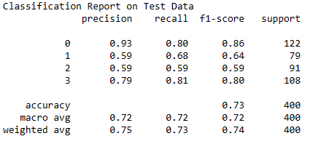
Adaboost Classifier

Slide 19

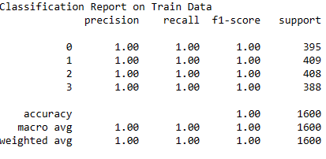
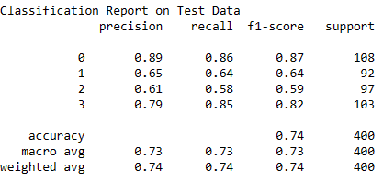
Gradient Boosting classifier

Slide 20

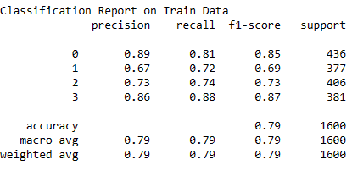
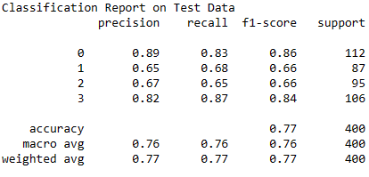
Logistic Regression

Slide 21
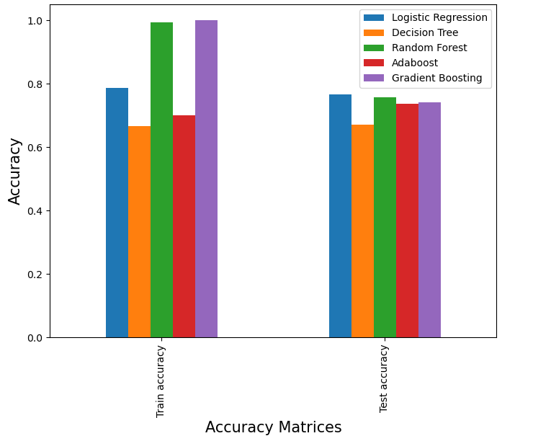
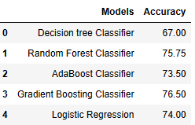
Base Model Conclusion
From the above Model we found the top 3 models with highest accuracy
Gradient Boosting classifier
Random Forest Classifier
Logistic Regression

Slide 22
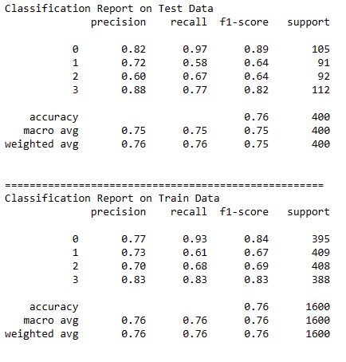
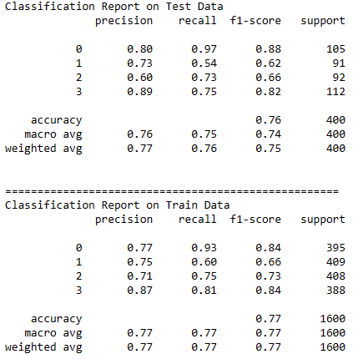
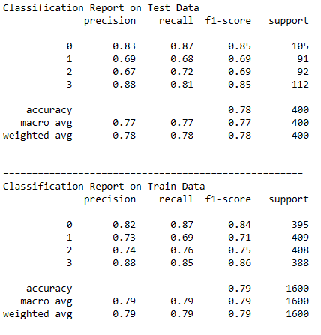
Hyperparameter Tunning
Gradient Boosting classifier
Random Forest Classifier
Logistic Regression

Slide 23
Conclusion
After performing the five algorithms of Machine learning to predict the accurate classify mobile phone we found there are 3 models which can be use for prediction of mobile phone.
Later we have to choose the best model for the prediction.
Hence after hyperparameter tunning we observe that “Logistic Regression” is the best model for the accurate classify of mobile phone.

Slide 24
Thank you

